Slide 1

18CSS202J- COMPUTER COMMUNICATION
UNIT III
Line Coding Schemes: Unipolar, Polar and Bipolar.
Amplitude Shift Keying Technique, Frequency Shift Keying Technique and Phase Shift Keying Technique
Pulse Code Modulation, Delta Modulation
Frequency division multiplexing, time division multiplexing and wavelength division multiplexing
Guided Media: Twisted pair, coaxial and Fiber optic cables.
Unguided Media: Radio waves, Microwaves and Infrared.

Slide 2
DIGITAL-TO-DIGITAL CONVERSION
Data can be either digital or analog. Signals that represent data can also be digital or analog. In this section, we see how we can represent digital data by using digital signals.
The conversion involves three techniques: line coding, block coding, and scrambling. Line coding is always needed; block coding and scrambling may or may not be needed.
Line coding is used to convert digital data to a digital signal. Line Coding Scheme is discussed here

Slide 3
Line Coding
Line coding is the process of converting digital data to digital signals
Converting a string of 1’s and 0’s (digital data) into a sequence of signals that denote the 1’s and 0’s.
For example a high voltage level (+V) could represent a “1” and a low voltage level (0 or -V) could represent a “0”.

Slide 4
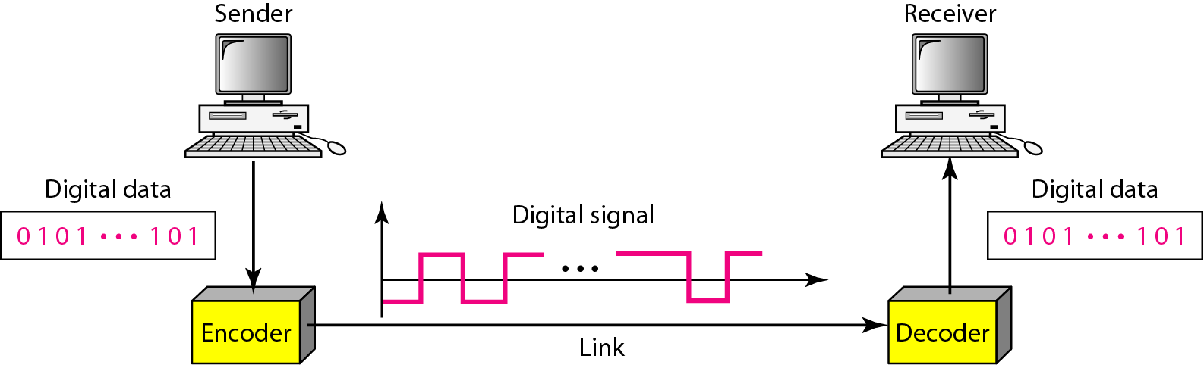
Line coding and decoding

Slide 5

Characteristics of different line coding schemes
Signal Element Versus Data Element
A data element is the smallest entity that can represent a piece of information: this is the bit. In digital data communications, a signal element carries data elements.
In other words, data elements are what we need to send; signal elements are
what we can send. Data elements are being carried; signal elements are the carriers.
The ratio represented by r is defined as the number of data elements carried by each signal element

Slide 6
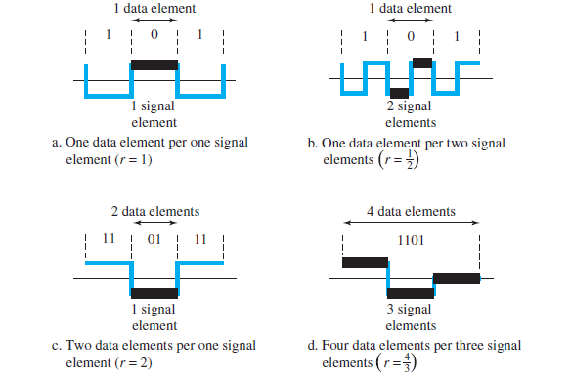

Slide 7
Data Rate Versus Signal Rate
The data rate defines the number of data elements (bits) sent in 1s. The unit is bits per second (bps).
The signal rate is the number of signal elements sent in 1s. The unit is the baud.
The data rate is sometimes called the bit rate; the signal rate is sometimes called the pulse rate, the modulation rate, or the baud rate.

Slide 8
One goal in data communications is to increase the data rate while decreasing the signal rate.
Increasing the data rate increases the speed of transmission; decreasing the signal rate decreases the bandwidth requirement.
the relationship between data rate (N) and signal rate (S)
S = N/r
the average signal rate is defined as
Save = c X N X (1/r) baud
C – case factor

Slide 9
Mapping Data symbols onto Signal levels
A data symbol (or element) can consist of a number of data bits:
1 , 0 or
11, 10, 01, ……
A data symbol can be coded into a single signal element or multiple signal elements
1 -> +V, 0 -> -V
1 -> +V and -V, 0 -> -V and +V
The ratio ‘r’ is the number of data elements carried by a signal element.

Slide 10
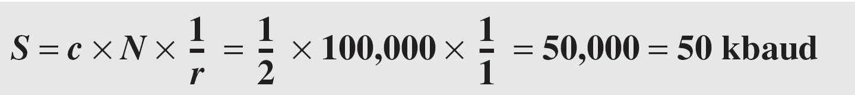
Example
A signal is carrying data in which one data element is encoded as one signal element ( r = 1). If the bit rate is 100 kbps, what is the average value of the baud rate if c is between 0 and 1?
Solution
We assume that the average value of c is 1/2 . The baud rate is then

Slide 11

Note
Although the actual bandwidth of a digital signal is infinite, the effective bandwidth is finite.

Slide 12
Example
The maximum data rate of a channel (see Chapter 3) is Nmax = 2 × B × log₂ L (defined by the Nyquist formula). Does this agree with the previous formula for N_{max}?
Solution
A signal with L levels actually can carry log₂L bits per level. If each level corresponds to one signal element and we assume the average case (c = 1/2), then we have

Slide 13
Considerations for choosing a good signal element referred to as line encoding
Baseline wandering - a receiver will evaluate the average power of the received signal (called the baseline) and use that to determine the value of the incoming data elements. If the incoming signal does not vary over a long period of time, the baseline will drift and thus cause errors in detection of incoming data elements.
A good line encoding scheme will prevent long runs of fixed amplitude.

Slide 14
Line encoding characteristics
DC components - when the voltage level remains constant for long periods of time, there is an increase in the low frequencies of the signal. Most channels are bandpass and may not support the low frequencies.
This will require the removal of the dc component of a transmitted signal.

Slide 15
Line encoding characteristics
Self synchronization - the clocks at the sender and the receiver must have the same bit interval.
If the receiver clock is faster or slower it will misinterpret the incoming bit stream.

Slide 16
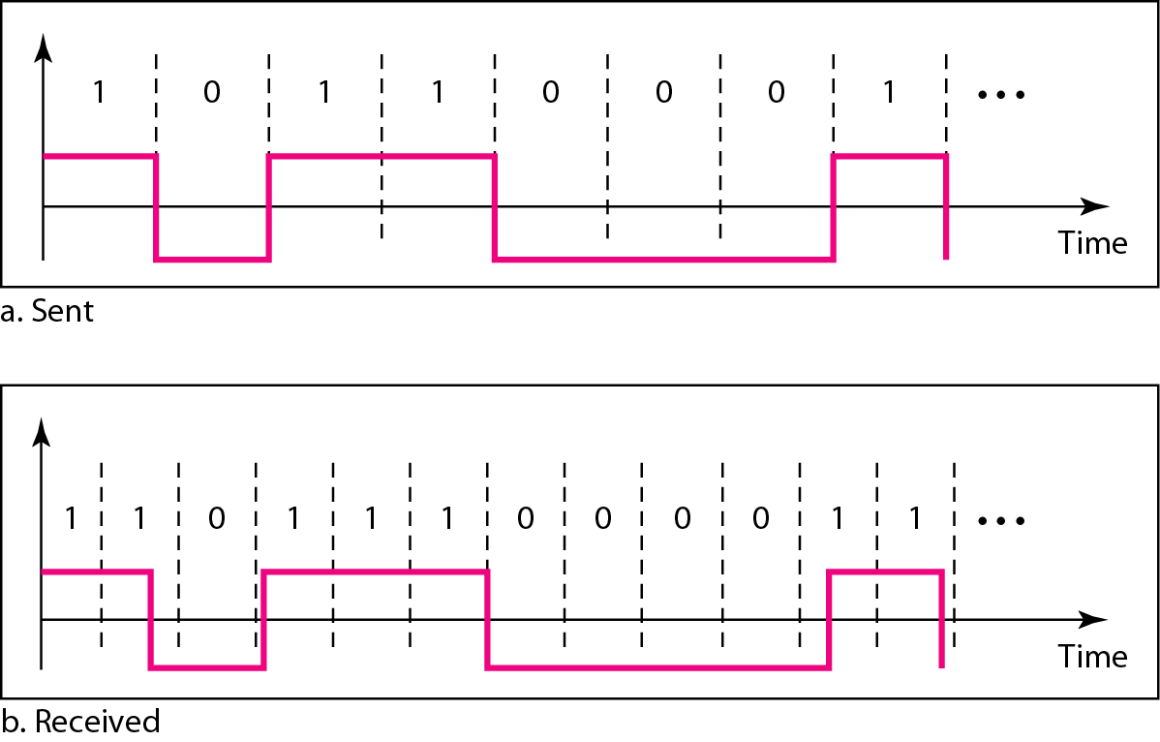
Figure 4.3 Effect of lack of synchronization

Slide 17
Example 4.3
In a digital transmission, the receiver clock is 0.1 percent faster than the sender clock. How many extra bits per second does the receiver receive if the data rate is 1 kbps? How many if the data rate is 1 Mbps?
At 1 kbps, the receiver receives 1001 bps instead of 1000 bps.
At 1 Mbps, the receiver receives 1,001,000 bps instead of 1,000,000 bps.

Slide 18
Line encoding characteristics
Error detection - errors occur during transmission due to line impairments.
Some codes are constructed such that when an error occurs it can be detected.

Slide 19
Line encoding characteristics
Noise and interference - there are line encoding techniques that make the transmitted signal “immune” to noise and interference.
This means that the signal cannot be corrupted, it is stronger than error detection.

Slide 20
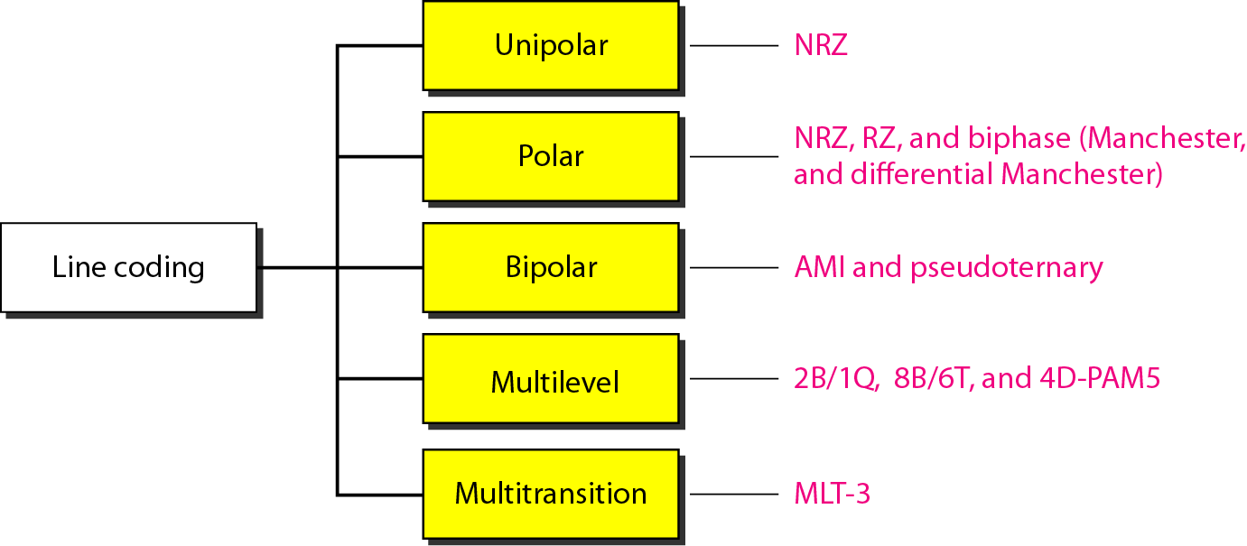
Figure Line coding schemes

Slide 21
Unipolar
All signal levels are on one side of the time axis , either above or below.
+v define 1 and –v define 0.
NRZ - Non Return to Zero scheme is an example of this code. The signal level does not return to zero at a middle of the bit.
Scheme is prone to baseline wandering and DC components. It has no synchronization or any error detection. It is simple but costly in power consumption.

Slide 22
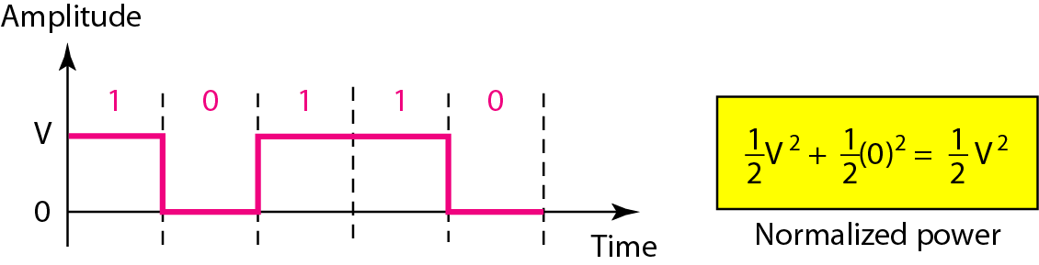
Figure Unipolar NRZ scheme

Slide 23
Polar - NRZ
The voltages are on both sides of the time axis.
Polar NRZ scheme can be implemented with two voltages. E.g. +V for 0 and -V for 1.
There are two versions:
NZR - Level (NRZ-L) - positive voltage for one symbol and negative for the other
NRZ - Inversion (NRZ-I) - the change or lack of change in polarity determines the value of a symbol. E.g. a “1” symbol inverts the polarity a “0” does not.

Slide 24
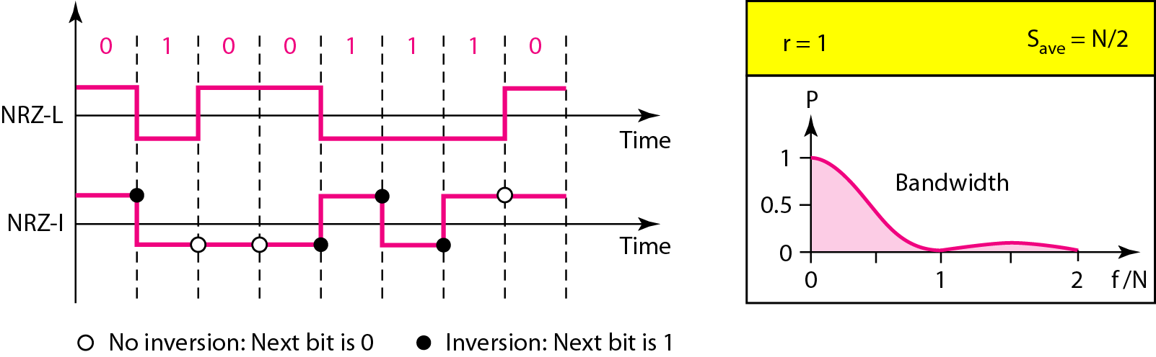
Figure 4.6 Polar NRZ-L and NRZ-I schemes

Slide 25
Note
In NRZ-L the level of the voltage determines the value of the bit. In NRZ-I the inversion or the lack of inversion determines the value of the bit.

Slide 26
Note
NRZ-L and NRZ-I both have an average signal rate of N/2 Bd.

Slide 27
Note
NRZ-L and NRZ-I both have a DC component problem and baseline wandering, it is worse for NRZ-L. Both have no self synchronization &no error detection. Both are relatively simple to implement.

Slide 28
Example
A system is using NRZ-I to transfer 10-Mbps data. What are the average signal rate and minimum bandwidth?
Solution
The average signal rate is S= N / 2 = 500 kbaud. The minimum bandwidth for this average baud rate is Bmin = S = 500 kHz.
Note c = 1/2 for the avg. case as worst case is 1 and best case is 0

Slide 29
Polar - RZ
The Return to Zero (RZ) scheme uses three voltage values. +, 0, -.
Each symbol has a transition in the middle. Either from high to zero or from low to zero.
This scheme has more signal transitions (two per symbol) and therefore requires a wider bandwidth.
No DC components or baseline wandering.
Not synchronized.
More complex as it uses three voltage level. It has no error detection capability.

Slide 30
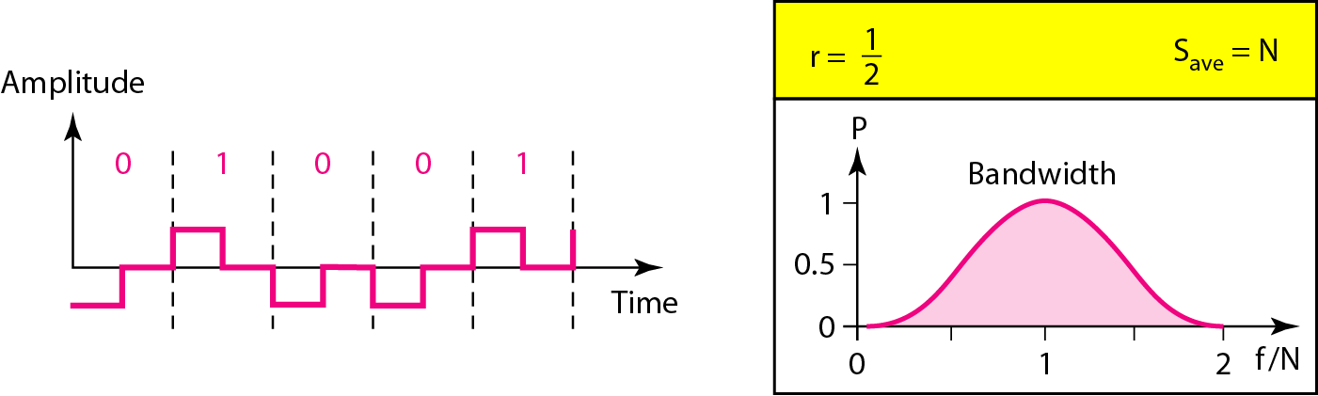
Figure 4.7 Polar RZ scheme

Slide 31
Polar - Biphase: Manchester and Differential Manchester
Manchester coding consists of combining the NRZ-L and RZ schemes.
Every symbol has a level transition in the middle: from high to low or low to high. Uses only two voltage levels.
Differential Manchester coding consists of combining the NRZ-I and RZ schemes.
Every symbol has a level transition in the middle. But the level at the beginning of the symbol is determined by the symbol value. One symbol causes a level change the other does not.

Slide 32
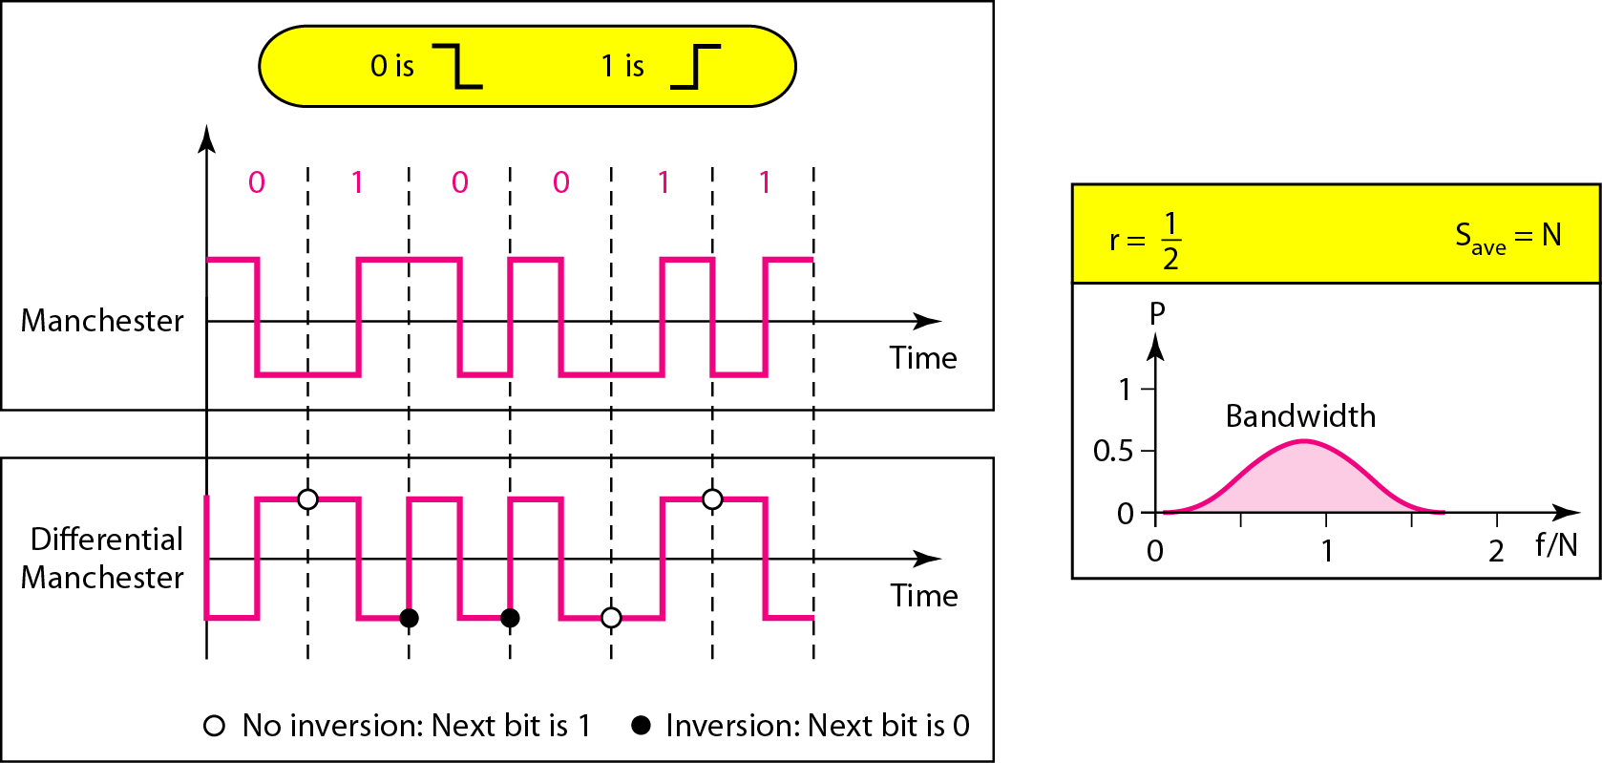
Figure 4.8 Polar biphase: Manchester and differential Manchester schemes

Slide 33
Note
In Manchester and differential Manchester encoding, the transition
at the middle of the bit is used for synchronization.

Slide 34
Note
The minimum bandwidth of Manchester and differential Manchester is 2 times that of NRZ. The is no DC component and no baseline wandering. None of these codes has error detection.

Slide 35
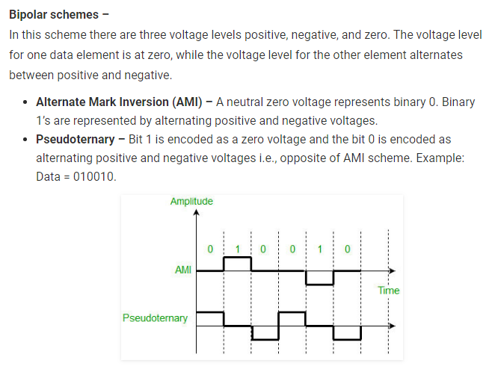

Slide 36
For example: B8ZS substitutes eight consecutive zeros with 000VB0VB.
The V stands for violation, it violates the line encoding rule
B stands for bipolar, it implements the bipolar line encoding rule

Slide 37
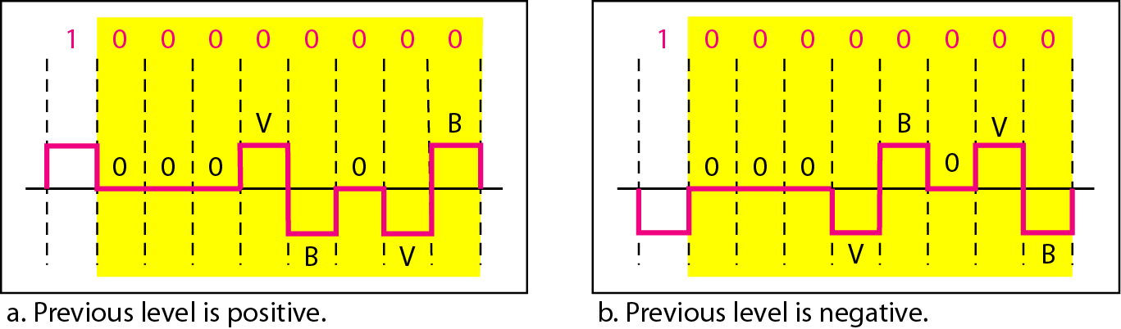
Figure 4.19 Two cases of B8ZS scrambling technique

Slide 38
HDB3 substitutes four consecutive zeros with 000V or B00V depending
on the number of nonzero pulses after the last substitution.
If # of non zero pulses is even the substitution is B00V to make total # of non zero pulse even.
If # of non zero pulses is odd the substitution is 000V to make total # of non zero pulses even.

Slide 39
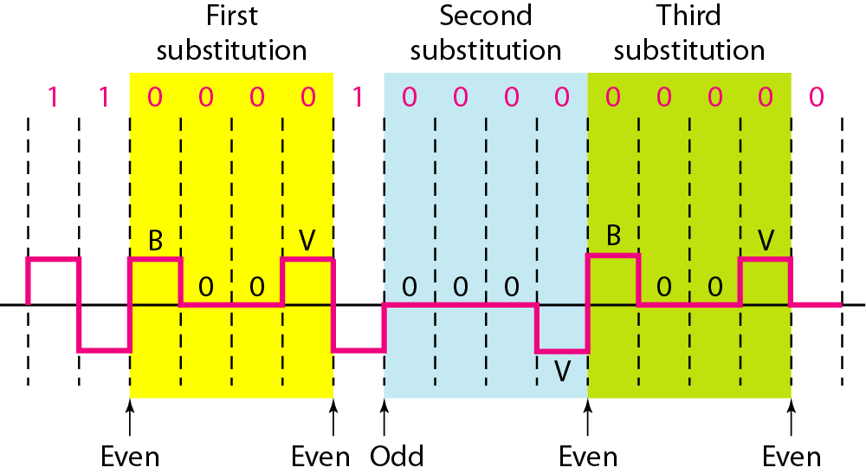
Figure 4.20 Different situations in HDB3 scrambling technique
Even – B00V + → -00-
- → +00+
Odd – 000V + → 000+
- → 000-

Slide 40
DIGITAL-TO-ANALOG CONVERSION

Slide 41
DIGITAL-TO-ANALOG CONVERSION
Topics to be discussed
Aspects of Digital-to-Analog Conversion
Amplitude Shift Keying
Frequency Shift Keying
Phase Shift Keying
Quadrature Amplitude Modulation

Slide 42
Digital to Analog Conversion
Converting digital data to a bandpass analog signal is traditionally called digital to- analog conversion
Digital-to-analog conversion is the process of changing one of the characteristics of an analog signal based on the information in digital data.
Digital data needs to be carried on an analog signal.
A carrier signal (frequency f_{c}) performs the function of transporting the digital data in an analog waveform.
The analog carrier signal is manipulated to uniquely identify the digital data being carried.

Slide 43
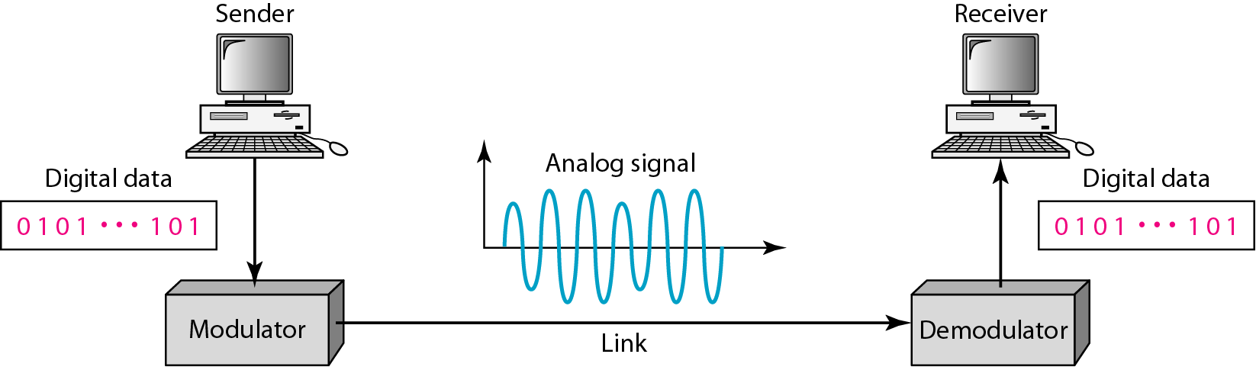
Figure 1 Digital-to-analog conversion
Figure 1 shows the relationship between the digital information, the digital-to-analog modulating process, and the resultant analog signal.

Slide 44
Types of digital-to-analog conversion
Four mechanisms are used for modulating digital data into an analog signal amplitude shift keying (ASK) frequency shift keying (FSK)
phase shift keying(PSK)
quadrature amplitude modulation (QAM – combines ASK &PSK)
QAM is the most efficient and commonly used today

Slide 45
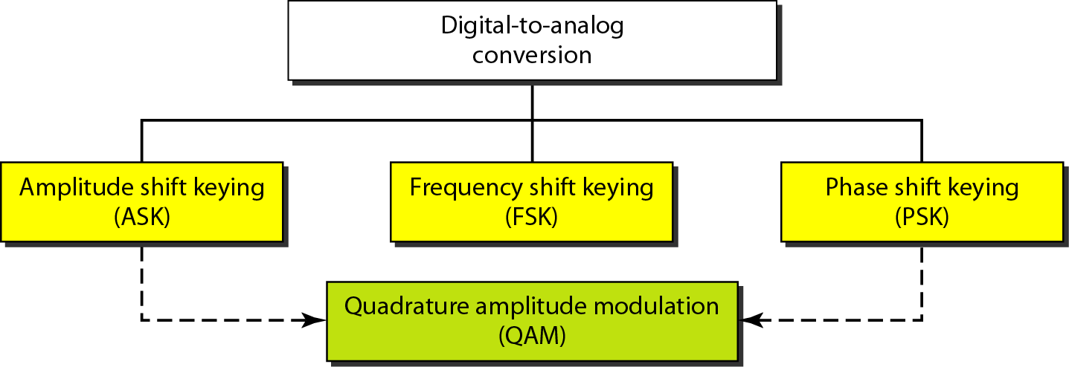
Figure 2 Types of digital-to-analog conversion

Slide 46

Bit and Baud rates and the carrier signal
Bit rate, N, is the number of bits per second (bps). Also called as Data Rate
Baud rate is the number of signal elements per second (bauds). Also called as Signal Rate

Slide 47
Cond..
The relationship between them is
S=Nx1/r bauds
Where
N - data rate
r - number of data bits per signal element.
In the analog transmission of digital data, the signal or baud rate is less than or equal to the bit rate.

Slide 48
Example 1
An analog signal carries 4 bits per signal element. If 1000 signal elements are sent per second, find the bit rate.
Solution
In this case, r = 4, S = 1000, and N is unknown. We can find the value of N from

Slide 49
Example 2
An analog signal has a bit rate of 8000 bps and a baud rate of 1000 baud. How many data elements are carried by each signal element? How many signal elements do we need?
Solution
In this example, S = 1000, N =8000, and rand L are unknown. We find first the value of rand then the value of L.

Slide 50
Amplitude Shift Keying (ASK)
In ASK, the amplitude of the carrier signal is varied to create signal elements. Both frequency and phase remain constant while the amplitude changes.
ASK is implemented by changing the amplitude of a carrier signal to reflect amplitude levels in the digital signal.
For example: a digital “1” could not affect the signal, whereas a digital “0” would, by making it zero.
The line encoding will determine the values of the analog waveform to reflect the digital data being carried.

Slide 51
Bandwidth of ASK
The bandwidth B of ASK is proportional to the signal rate S.
B = (1+d)S
“d” is depends on modulation and filtering process
“d” value lies between 0 and 1.

Slide 52
Binary ASK (BASK)
ASK is normally implemented using only two levels.
This is referred to as binary amplitude shift keying or on-off keying (OOK).
The peak amplitude of one signal level is 0
the other is the same as the amplitude of the carrier frequency

Slide 53
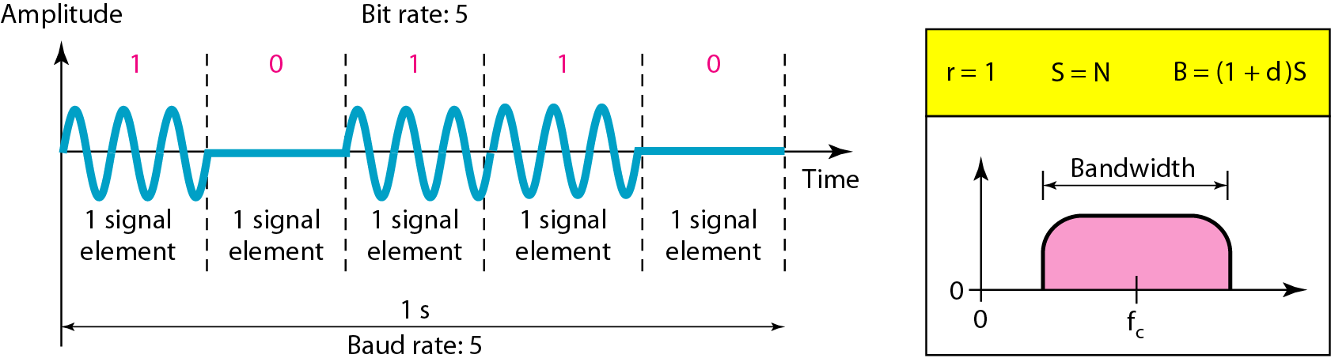
Figure 3 Binary amplitude shift keying

Slide 54
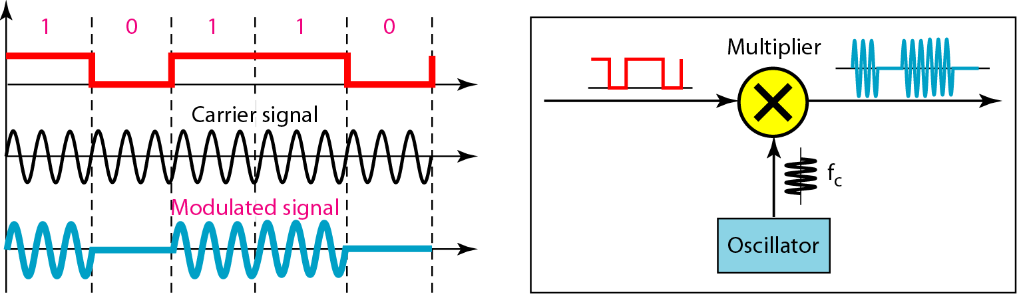
Figure 4 Implementation of binary ASK

Slide 55
If digital data are presented as a unipolar NRZ digital signal with a high voltage of I V and a low voltage of 0 V
Implementation can achieved by multiplying the NRZ digital signal by the carrier signal coming from an oscillator.
When the amplitude of the NRZ signal is 1, the amplitude of the carrier frequency is held;
when the amplitude of the NRZ signal is 0, the amplitude of the carrier frequency is zero.

Slide 56
Example 3
We have an available bandwidth of 100 kHz which spans from 200 to 300 kHz. What are the carrier frequency and the bit rate if we modulated our data by using ASK with d =I?
Solution
The middle of the bandwidth is located at 250 kHz. This means that our carrier frequency can be at fe =250 kHz. We can use the formula for bandwidth to find the bit rate (with d =1 and r =1).

Slide 57
Example 4
In data communications, we normally use full-duplex links with communication in both directions. We need to divide the bandwidth into two with two carrier frequencies, as shown in Figure 5. The figure shows the positions of two carrier frequencies and the bandwidths. The available bandwidth for each direction is now 50 kHz, which leaves us with a data rate of 25 kbps in each direction.

Slide 58
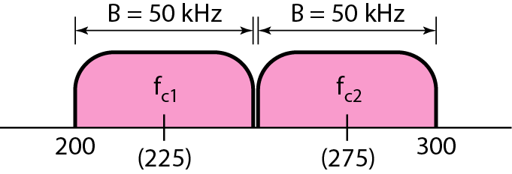
Figure 5 Bandwidth of full-duplex ASK used in Example 4

Slide 59
Frequency Shift Keying
In frequency shift keying, the frequency of the carrier signal is varied to represent data.
The frequency of the modulated signal is constant for the duration of one signal element, but changes for the next signal element if the data element changes.
Both peak amplitude and phase remain constant for all signal elements.
The digital data stream changes the frequency of the carrier signal, f_{c}.
For example,
a “1” could be represented by f₁=f_{c} +Δf,
a “0” could be represented by f₂=f_{c}-Δf.

Slide 60
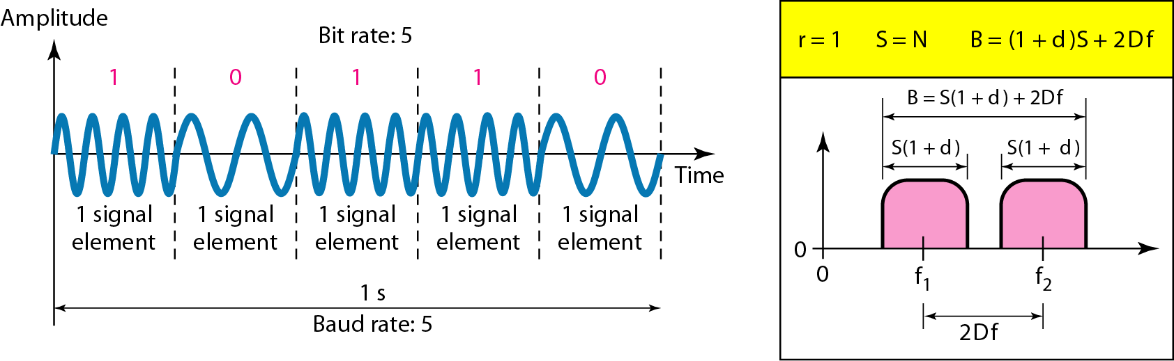
Figure 6 Binary frequency shift keying (BFSK)

Slide 61
Bandwidth of FSK
If the difference between the two frequencies (f₁ and f₂) is 2Δf, then the required BW B will be:
B = (1+d)xS +2Δf

Slide 62
Example 5
We have an available bandwidth of 100 kHz which spans from 200 to 300 kHz. What should be the carrier frequency and the bit rate if we modulated our data by using FSK with d = 1?
Solution
This problem is similar to Example 5.3, but we are modulating by using FSK. The midpoint of the band is at 250 kHz. We choose 2Δf to be 50 kHz; this means

Slide 63
Coherent and Non Coherent
Two implementations of BFSK:
noncoherent and coherent.
In a non-coherent FSK scheme, when we change from one frequency to the other, we do not adhere to the current phase of the signal.
In coherent FSK, the switch from one frequency signal to the other only occurs at the same phase in the signal.

Slide 64
Noncoherent BFSK can be implemented by treating
BFSK as two ASK modulations and using two carrier frequencies.
Coherent BFSK can be implemented by using one voltage-controlled oscillator (VeO) that changes its frequency according to the input voltage.
Figure 7 shows the simplified idea behind the
second implementation.
The input to the oscillator is the unipolar NRZ signal.
When the amplitude of NRZ is zero, the oscillator keeps its regular frequency;
when the amplitude is positive, the frequency is increased.

Slide 65
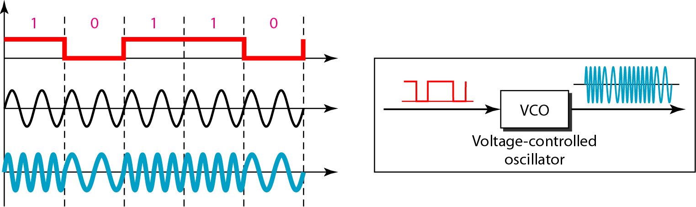
Figure 7 Implementation of BFSK

Slide 66
Multi level FSK
Similarly to ASK, FSK can use multiple bits per signal element.
That means we need to provision for multiple frequencies, each one to represent a group of data bits.
The bandwidth for FSK can be higher
B = (1+d)xS + (L-1)/2Δf = LxS

Slide 67
Example 6
We need to send data 3 bits at a time at a bit rate of 3 Mbps. The carrier frequency is 10 MHz. Calculate the number of levels (different frequencies), the baud rate, and the bandwidth.
Solution
We can have L = 2³ = 8. The baud rate is S = 3 Mbps/3 = 1 Mbaud. This means that the carrier frequencies must be 1 MHz apart (2Δf = 1 MHz). The bandwidth is B = 8 × 1M = 8M. Figure 8 shows the allocation of frequencies and bandwidth.

Slide 68
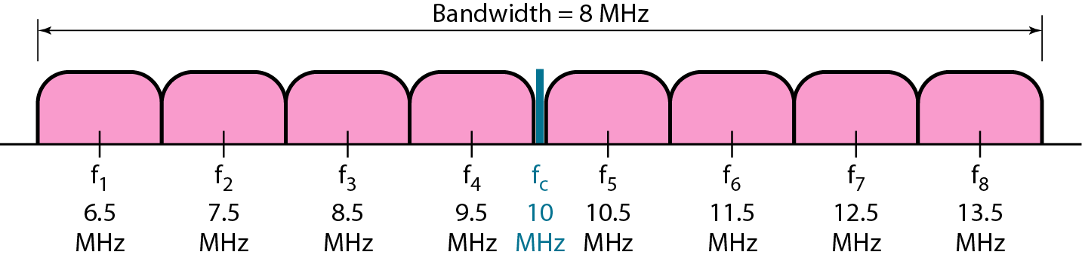
Figure 8 Bandwidth of MFSK used in Example 6

Slide 69
Phase Shift Keying
In PSK, the phase of the carrier is varied to represent two or more different signal elements. Both peak amplitude and frequency remain constant as the phase changes.
Today, PSK is more common than ASK or FSK
We vary the phase shift of the carrier signal to represent digital data.
The bandwidth requirement, B is:
B = (1+d)xS
PSK is much more robust than ASK as it is not that vulnerable to noise, which changes amplitude of the signal.

Slide 70
Binary phase shift keying (BPSK)
The simplest PSK is binary PSK, in which we have only two signal elements, one with
a phase of 0°, and the other with a phase of 180°
Binary PSK is as simple as binary ASK
PSK is less susceptible to noise than ASK.
PSK is superior to FSK because we do not need two carrier signals.

Slide 71
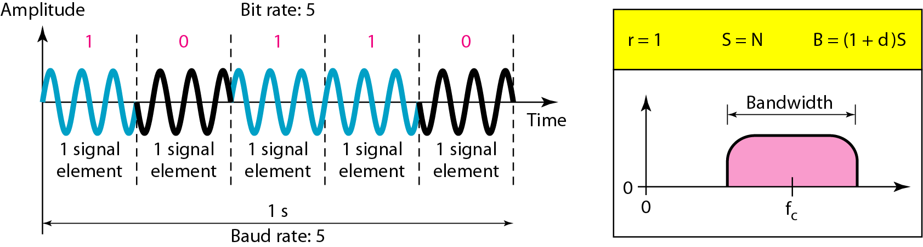
Figure 9 Binary phase shift keying

Slide 72
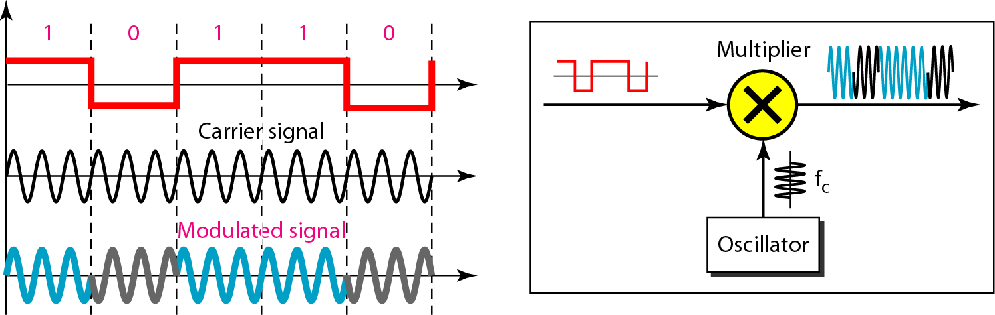
Figure 10 Implementation of BASK

Slide 73
The implementation of BPSK is as simple as that for ASK
The reason is that the signal element with phase 180° can be seen as the complement of the signal element with phase 0°
The polar NRZ signal is multiplied by the carrier frequency;
the 1 bit (positive voltage) is represented by a phase starting at 0°;
the 0 bit (negative voltage) is represented by a phase starting at 180°.

Slide 74
Quadrature PSK
To increase the bit rate, we can code 2 or more bits onto one signal element.
In QPSK, we parallelize the bit stream so that every two incoming bits are split up and PSK a carrier frequency. One carrier frequency is phase shifted 90º from the other - in quadrature.
The two PSKed signals are then added to produce one of 4 signal elements. L = 4 here.

Slide 75
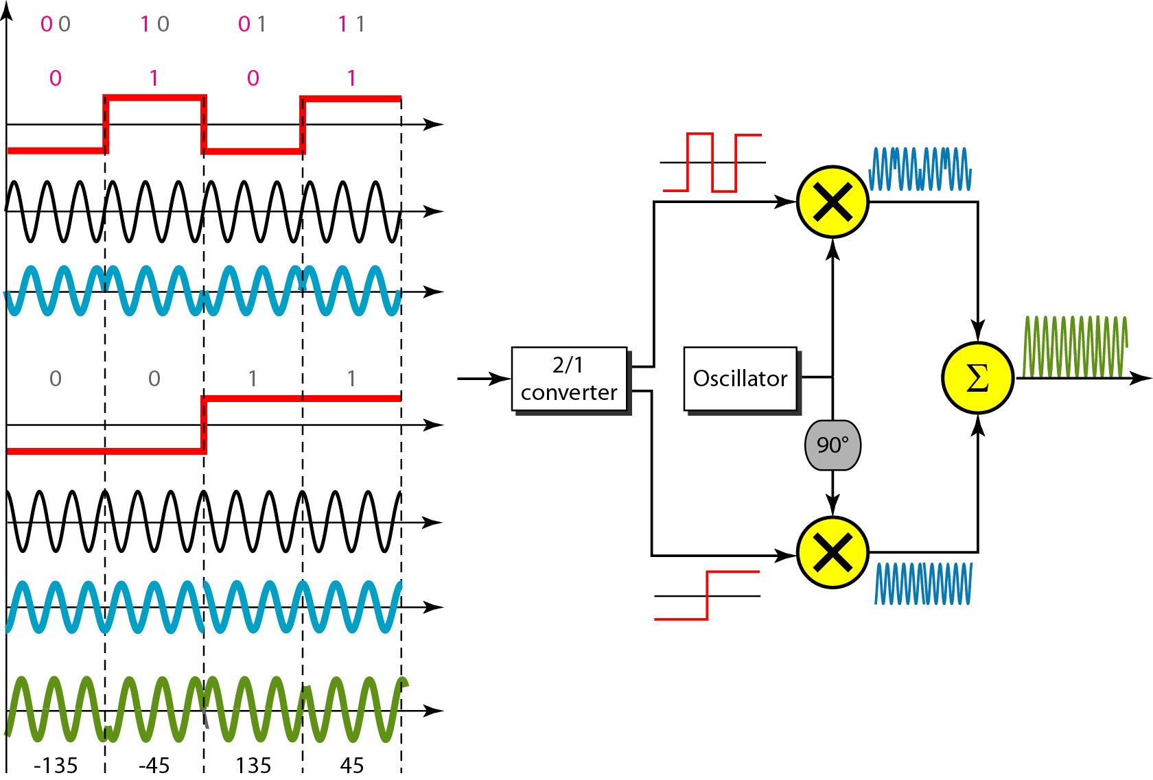
Figure 11 QPSK and its implementation

Slide 76
Example 7
Find the bandwidth for a signal transmitting at 12 Mbps for QPSK. The value of d = 0.
Solution
For QPSK, 2 bits is carried by one signal element. This means that r = 2. So the signal rate (baud rate) is S = N × (1/r) = 6 Mbaud. With a value of d = 0, we have B = S = 6 MHz.

Slide 77
Constellation Diagrams
A constellation diagram helps us to define the amplitude and phase of a signal when we are using two carriers, one in quadrature of the other.
The X-axis represents the in-phase carrier and the Y-axis represents quadrature carrier.

Slide 78
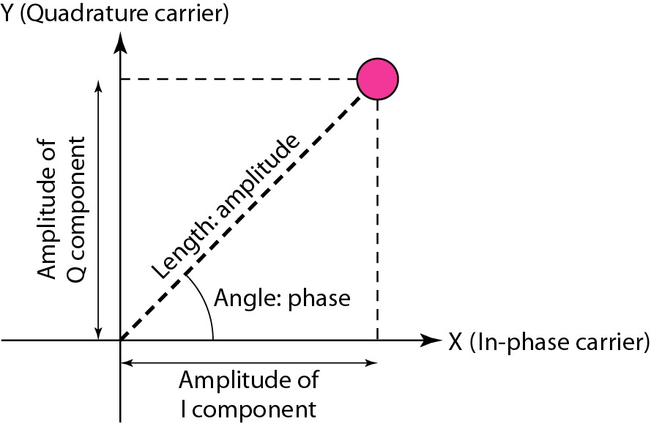
Figure 12 Concept of a constellation diagram

Slide 79
Example 8
Show the constellation diagrams for an ASK (OOK), BPSK, and QPSK signals.
Solution
Figure 5.13 shows the three constellation diagrams.

Slide 80
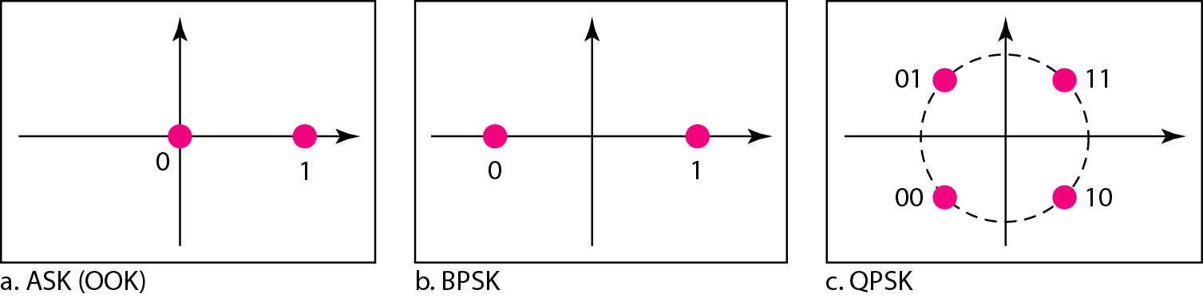
Figure 13 Three constellation diagrams

Slide 81
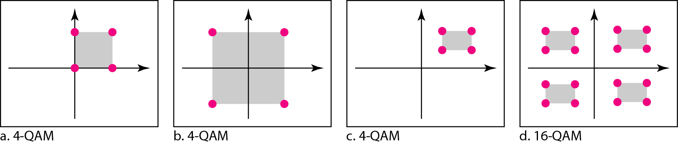
Quadrature amplitude modulation (QAM) QAM is a combination of ASK and PSK. Figure 14 Constellation diagrams for some QAMs

Slide 82
Bandwidth for QAM
The minimum bandwidth required for QAM transmission is the same as that required
for ASK and PSK transmission.
QAM has the same advantages as PSK over ASK.

Slide 83
ANALOG TO DIGITAL CONVERSION

Slide 84
ANALOG-TO-DIGITAL CONVERSION
A digital signal is superior to an analog signal because it is more robust to noise and can easily be recovered, corrected and amplified. For this reason, the tendency today is to change an analog signal to digital data. In this section we describe two techniques, pulse code modulation and delta modulation.
Topics discussed in this section:
Pulse Code Modulation (PCM)
Delta Modulation (DM)

Slide 85
PCM
PCM consists of three steps to digitize an analog signal:
Sampling
Quantization
Binary encoding
Before we sample, we have to filter the signal to limit the maximum frequency of the signal as it affects the sampling rate.
Filtering should ensure that we do not distort the signal, i.e. remove high frequency components that affect the signal shape.

Slide 86
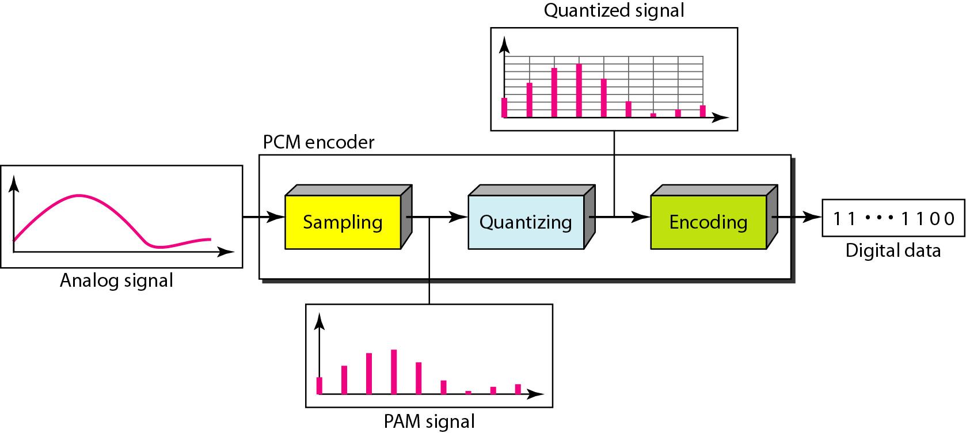
Components of PCM encoder

Slide 87
Sampling
Analog signal is sampled every T_{S} secs.
T_{s} is referred to as the sampling interval.
f_{s} = 1/T_{s} is called the sampling rate or sampling frequency.
There are 3 sampling methods:
Ideal - an impulse at each sampling instant
Natural - a pulse of short width with varying amplitude
Flattop - sample and hold, like natural but with single amplitude value
The process is referred to as pulse amplitude modulation PAM and the outcome is a signal with analog (non integer) values

Slide 88
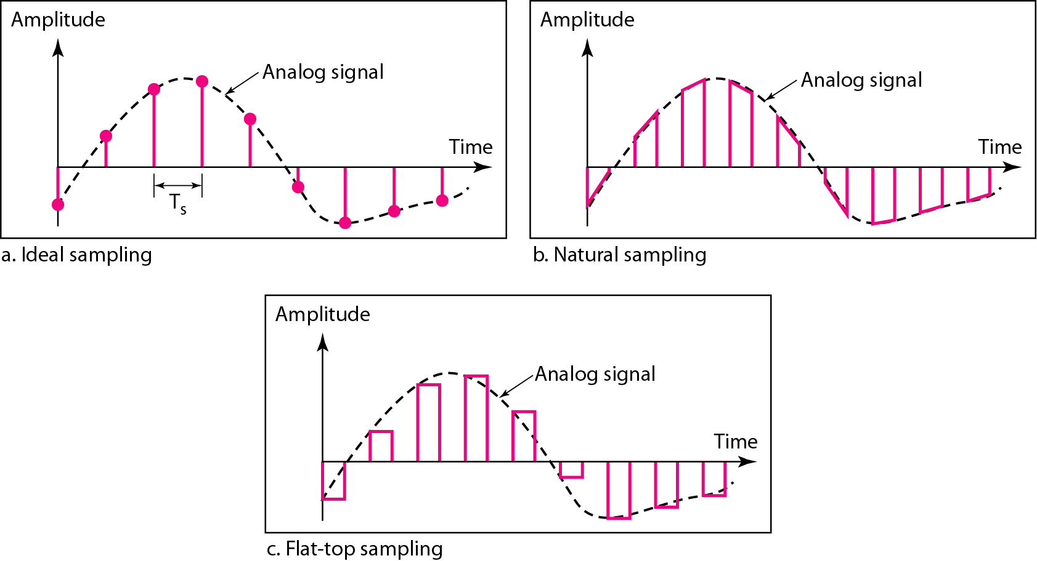
Three different sampling methods for PCM

Slide 89
Note
According to the Nyquist theorem, the sampling rate must be
at least 2 times the highest frequency contained in the signal.

Slide 90
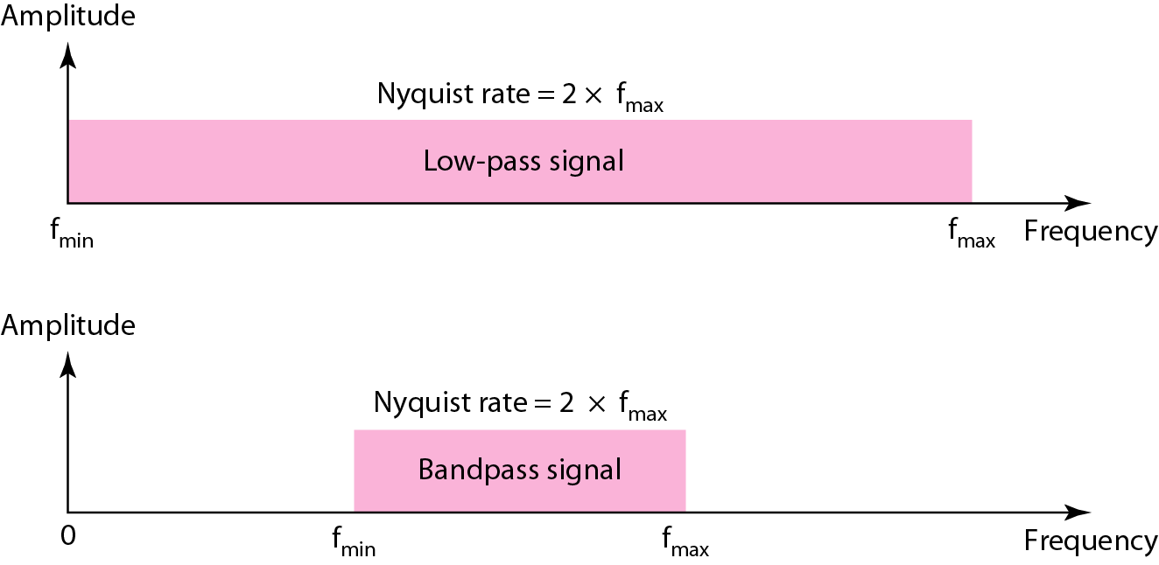
Nyquist sampling rate for low-pass and bandpass signals

Slide 91
Example 1
For an intuitive example of the Nyquist theorem, let us sample a simple sine wave at three sampling rates: f_{s} = 4f (2 times the Nyquist rate), f_{s} = 2f (Nyquist rate), and f_{s} = f (one-half the Nyquist rate). Figure 4.24 shows the sampling and the subsequent recovery of the signal.
It can be seen that sampling at the Nyquist rate can create a good approximation of the original sine wave (part a). Oversampling in part b can also create the same approximation, but it is redundant and unnecessary. Sampling below the Nyquist rate (part c) does not produce a signal that looks like the original sine wave.

Slide 92
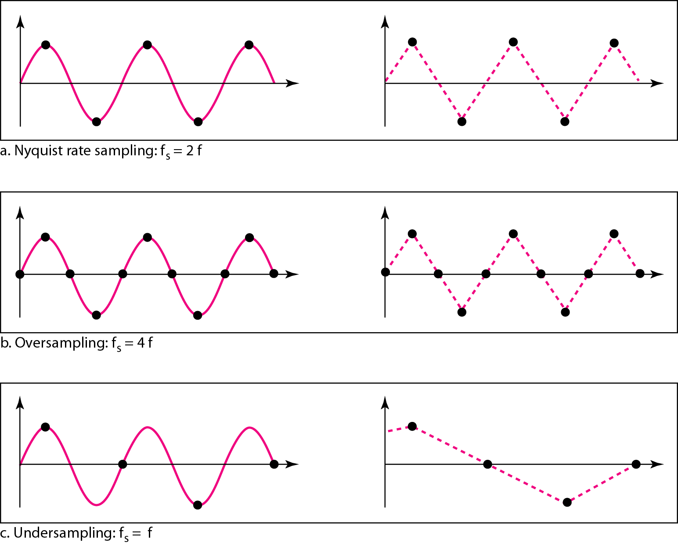
Recovery of a sampled sine wave for different sampling rates

Slide 93
Example 2
Consider the revolution of a hand of a clock. The second hand of a clock has a period of 60 s. According to the Nyquist theorem, we need to sample the hand every 30 s (T_{s} = T or f_{s} = 2f ). In Figure 4.25a, the sample points, in order, are 12, 6, 12, 6, 12, and 6. The receiver of the samples cannot tell if the clock is moving forward or backward. In part b, we sample at double the Nyquist rate (every 15 s). The sample points are 12, 3, 6, 9, and 12. The clock is moving forward. In part c, we sample below the Nyquist rate (T_{s} = T or f_{s} = f ). The sample points are 12, 9, 6, 3, and 12. Although the clock is moving forward, the receiver thinks that the clock is moving backward.

Slide 94
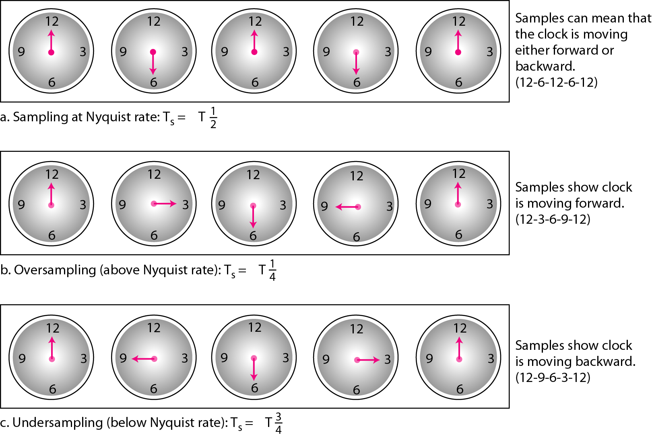
4.25 Sampling of a clock with only one hand

Slide 95
Quantization
Sampling results in a series of pulses of varying amplitude values ranging between two limits: a min and a max.
The amplitude values are infinite between the two limits.
We need to map the infinite amplitude values onto a finite set of known values.
This is achieved by dividing the distance between min and max into L zones, each of height Δ.
Δ = (max - min)/L

Slide 96
Quantization Levels
The midpoint of each zone is assigned a value from 0 to L-1 (resulting in L values)
Each sample falling in a zone is then approximated to the value of the midpoint

Slide 97
Quantization Zones
Assume we have a voltage signal with amplitudes V_{min}=-20V and V_{max}=+20V.
We want to use L=8 quantization levels.
Zone width Δ = (20 - -20)/8 = 5
The 8 zones are: -20 to -15, -15 to -10, -10 to -5, -5 to 0, 0 to +5, +5 to +10, +10 to +15, +15 to +20
The midpoints are: -17.5, -12.5, -7.5, -2.5, 2.5, 7.5, 12.5, 17.5

Slide 98
Assigning Codes to Zones
Each zone is then assigned a binary code.
The number of bits required to encode the zones, or the number of bits per sample as it is commonly referred to, is obtained as follows:
n_{b} = log₂ L
Given our example, n_{b} = 3
The 8 zone (or level) codes are therefore: 000, 001, 010, 011, 100, 101, 110, and 111
Assigning codes to zones:
000 will refer to zone -20 to -15
001 to zone -15 to -10, etc.

Slide 99
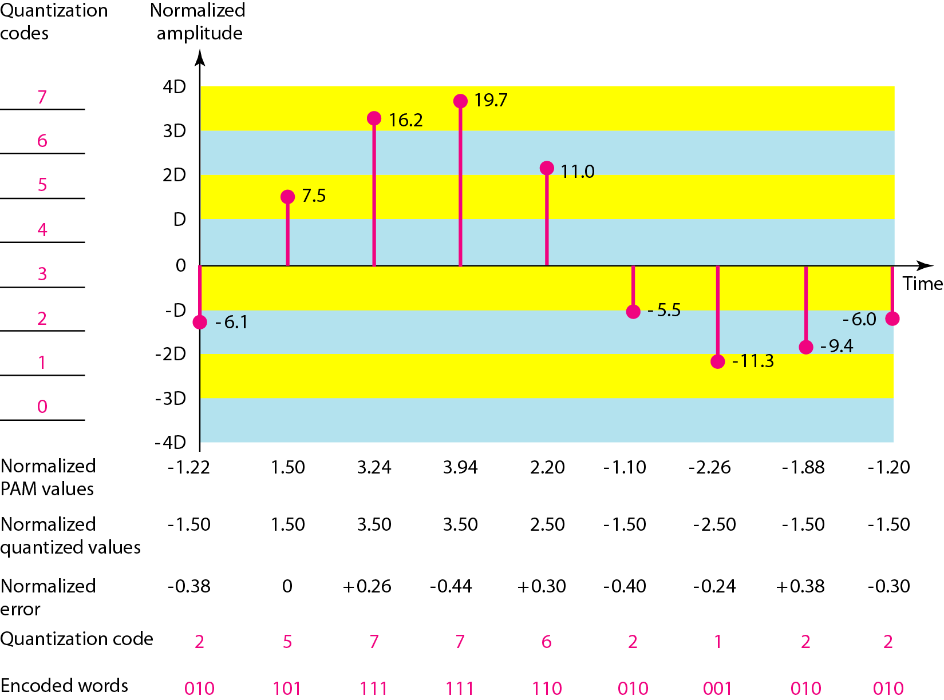
Quantization and encoding of a sampled signal

Slide 100
Quantization Error
When a signal is quantized, we introduce an error - the coded signal is an approximation of the actual amplitude value.
The difference between actual and coded value (midpoint) is referred to as the quantization error.
The more zones, the smaller Δ which results in smaller errors.
BUT, the more zones the more bits required to encode the samples -> higher bit rate

Slide 101
Quantization Error and SN_{Q}R
Signals with lower amplitude values will suffer more from quantization error as the error range: Δ/2, is fixed for all signal levels.
Non linear quantization is used to alleviate this problem. Goal is to keep SN_{Q}R fixed for all sample values.
Two approaches:
The quantization levels follow a logarithmic curve. Smaller Δ’s at lower amplitudes and larger Δ’s at higher amplitudes.
Companding: The sample values are compressed at the sender into logarithmic zones, and then expanded at the receiver. The zones are fixed in height.

Slide 102
Bit rate and bandwidth requirements of PCM
The bit rate of a PCM signal can be calculated form the number of bits per sample x the sampling rate
Bit rate = n_{b} x f_{s}
The bandwidth required to transmit this signal depends on the type of line encoding used. Refer to previous section for discussion and formulas.
A digitized signal will always need more bandwidth than the original analog signal. Price we pay for robustness and other features of digital transmission.

Slide 103
Example
We want to digitize the human voice. What is the bit rate, assuming 8 bits per sample?
Solution
The human voice normally contains frequencies from 0 to 4000 Hz. So the sampling rate and bit rate are calculated as follows:

Slide 104
PCM Decoder
To recover an analog signal from a digitized signal we follow the following steps:
We use a hold circuit that holds the amplitude value of a pulse till the next pulse arrives.
We pass this signal through a low pass filter with a cutoff frequency that is equal to the highest frequency in the pre-sampled signal.
The higher the value of L, the less distorted a signal is recovered.

Slide 105
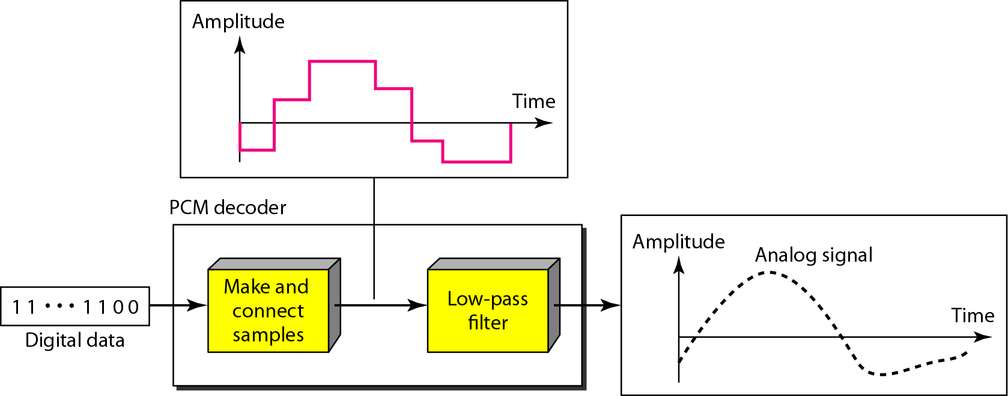
Components of a PCM decoder

Slide 106
Delta Modulation
This scheme sends only the difference between pulses, if the pulse at time t_{n+1} is higher in amplitude value than the pulse at time t_{n}, then a single bit, say a “1”, is used to indicate the positive value.
If the pulse is lower in value, resulting in a negative value, a “0” is used.
This scheme works well for small changes in signal values between samples.
If changes in amplitude are large, this will result in large errors.

Slide 107
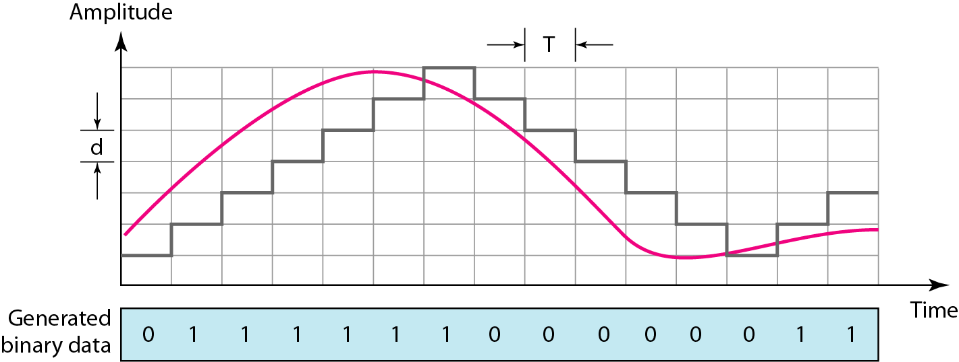
The process of delta modulation

Slide 108
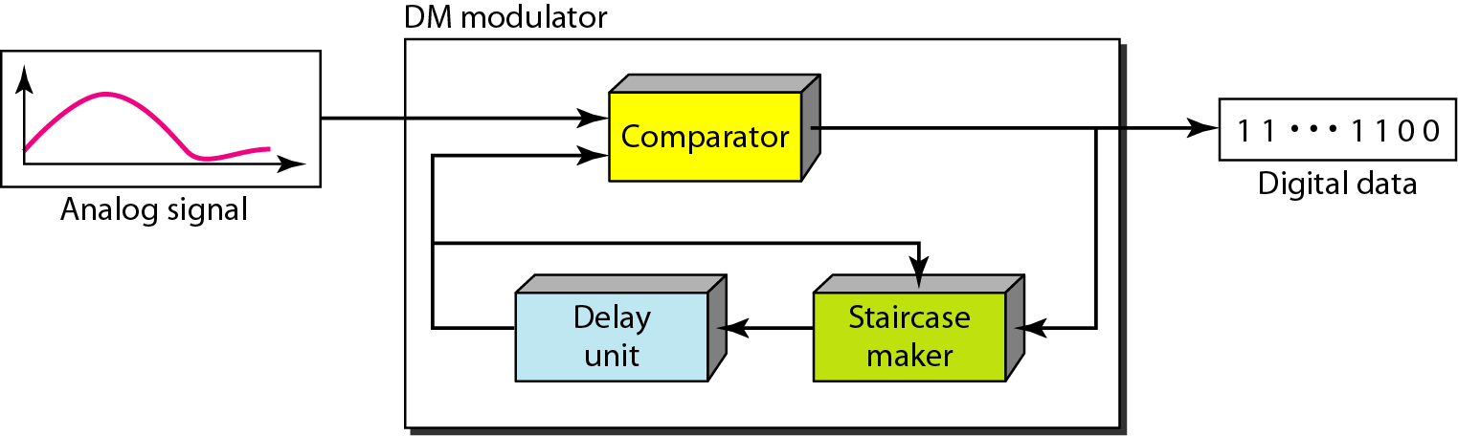
Delta modulation components

Slide 109
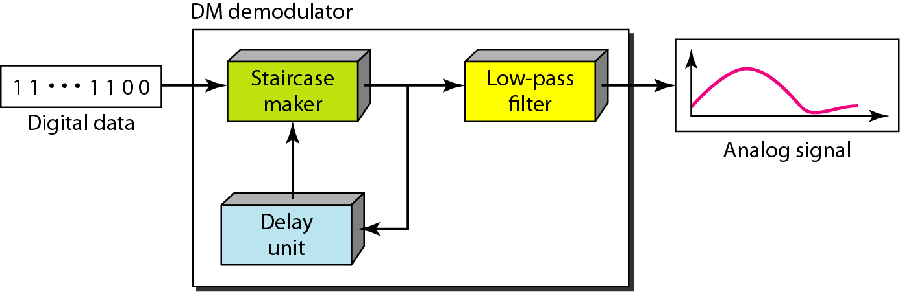
Delta demodulation components

Slide 110
Delta PCM (DPCM)
Instead of using one bit to indicate positive and negative differences, we can use more bits -> quantization of the difference.
Each bit code is used to represent the value of the difference.
The more bits the more levels -> the higher the accuracy.

Slide 111
Multiplexing : Sharing a Medium

Slide 112
Introduction
Under the simplest conditions, a medium can carry only one signal at any moment in time.
For multiple signals to share one medium, the medium must somehow be divided, giving each signal a portion of the total bandwidth.
The current techniques that can accomplish this include
frequency division multiplexing (FDM)
time division multiplexing (TDM)
Synchronous vs statistical
wavelength division multiplexing (WDM)
code division multiplexing (CDM)

Slide 113
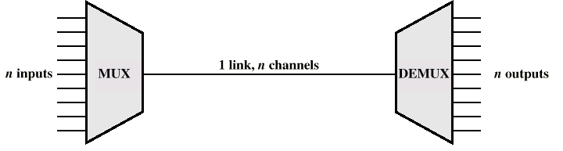
Multiplexing
Multiplexor (MUX)
Demultiplexor (DEMUX)
Sometimes just called a MUX

Slide 114
Multiplexing
Two or more simultaneous transmissions on a single circuit.
Transparent to end user.
Multiplexing costs less.

Slide 115
Frequency Division Multiplexing
Assignment of non-overlapping frequency ranges to each “user” or signal on a medium. Thus, all signals are transmitted at the same time, each using different frequencies.
A multiplexor accepts inputs and assigns frequencies to each device.
The multiplexor is attached to a high-speed communications line.
A corresponding multiplexor, or de-multiplexor, is on the end of the high-speed line and separates the multiplexed signals.

Slide 116
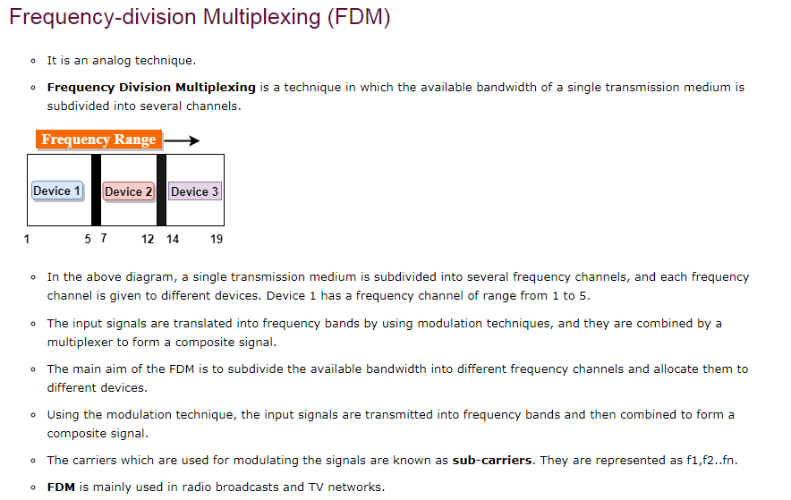

Slide 117
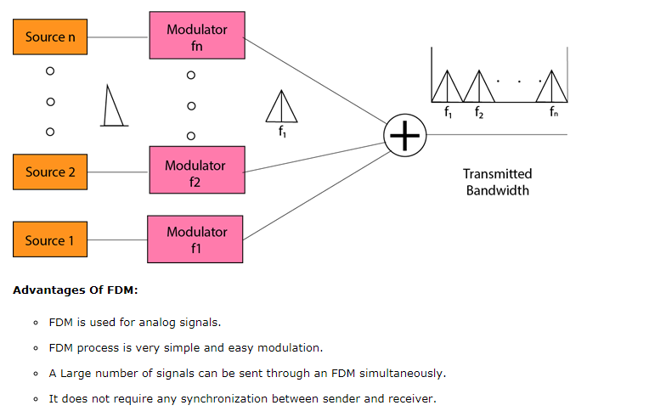

Slide 118
Frequency Division Multiplexing
Analog signaling is used to transmits the signals.
Broadcast radio and television, cable television, and the AMPS cellular phone systems use frequency division multiplexing.
This technique is the oldest multiplexing technique.
Since it involves analog signaling, it is more susceptible to noise.

Slide 119
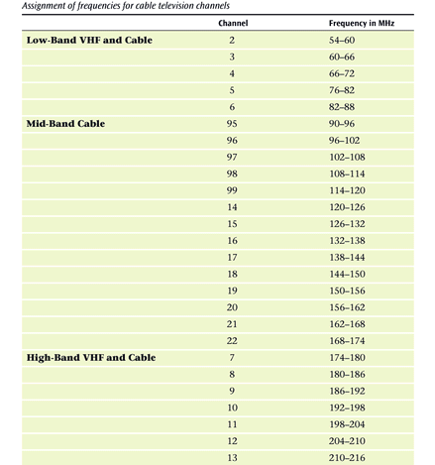

Slide 120
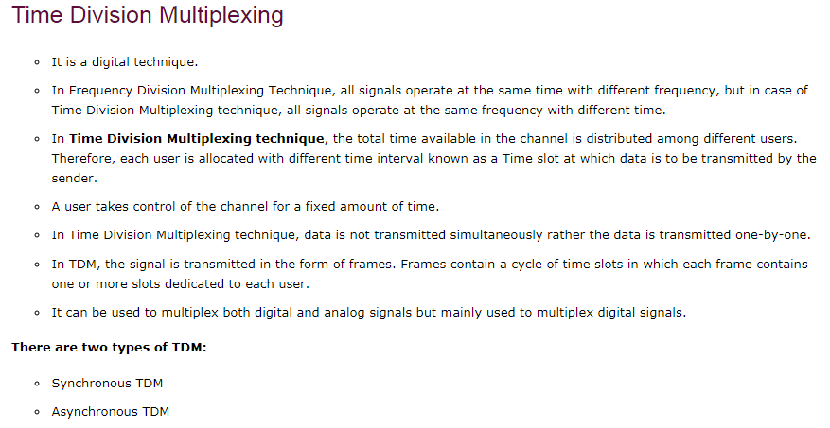

Slide 121
Synchronous Time Division Multiplexing
The original time division multiplexing.
The multiplexor accepts input from attached devices in a round-robin fashion and transmit the data in a never ending pattern.
T-1 and ISDN telephone lines are common examples of synchronous time division multiplexing.

Slide 122
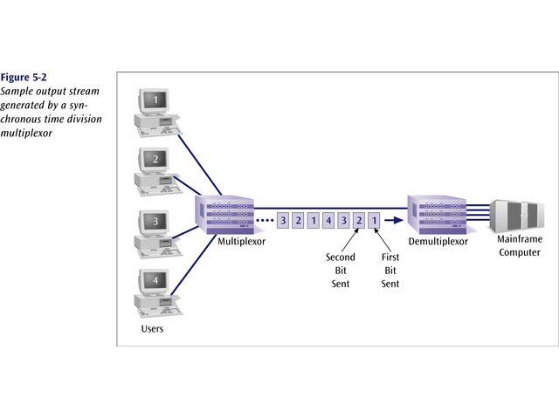
Sample Output Stream generated by a
Synchronous Time Division Multiplexing

Slide 123
Synchronous Time Division Multiplexing
If one device generates data at a faster rate than other devices, then the multiplexor must either sample the incoming data stream from that device more often than it samples the other devices, or buffer the faster incoming stream.
If a device has nothing to transmit, the multiplexor must still insert a piece of data from that device into the multiplexed stream.

Slide 124
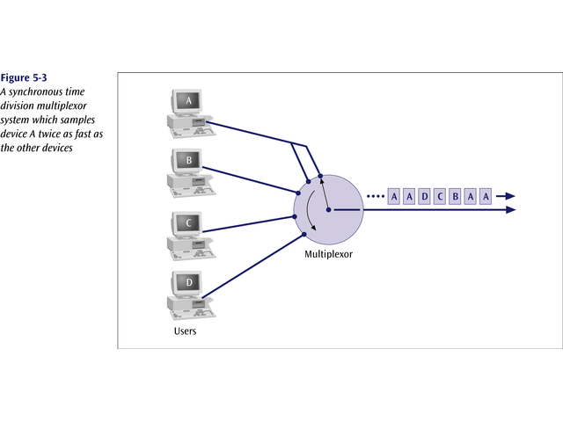
Example

Slide 125
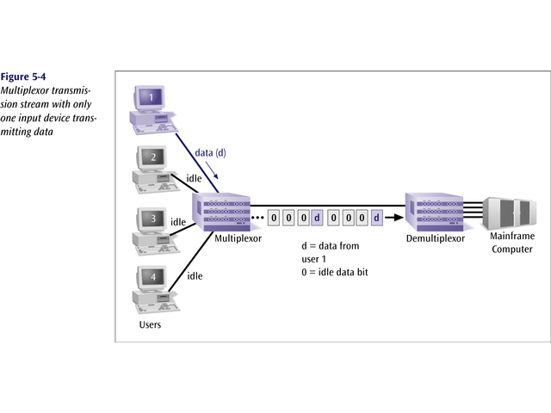

Slide 126
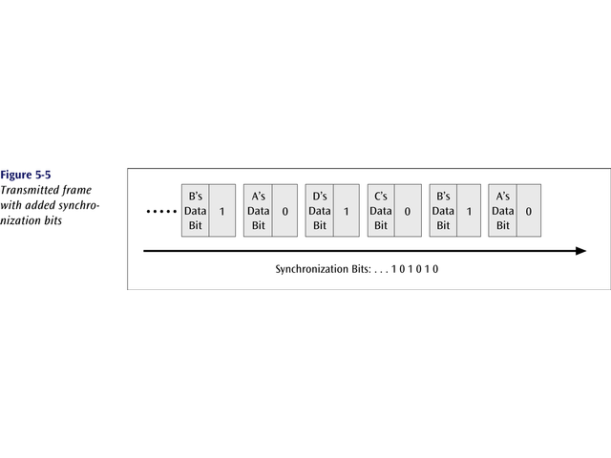
Synchronous time division multiplexing
So that the receiver may stay synchronized with the incoming data stream, the transmitting multiplexor can insert alternating 1s and 0s into the data stream.

Slide 127
Synchronous Time Division Multiplexing
Three types popular today:
T-1 multiplexing (the classic)
ISDN multiplexing
SONET (Synchronous Optical NETwork)

Slide 128
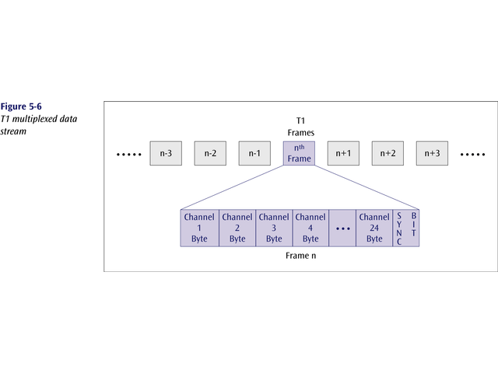
The T1 (1.54 Mbps) multiplexor stream is a continuous series of frames of both digitized data and voice channels.
24 separate 64Kbps channels

Slide 129
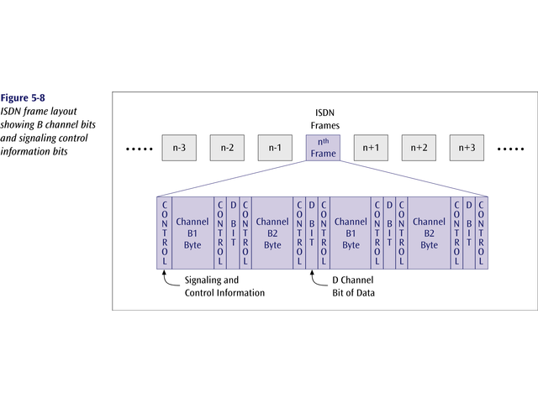
The ISDN multiplexor stream is also a continuous stream of frames. Each frame contains various control and sync info.

Slide 130
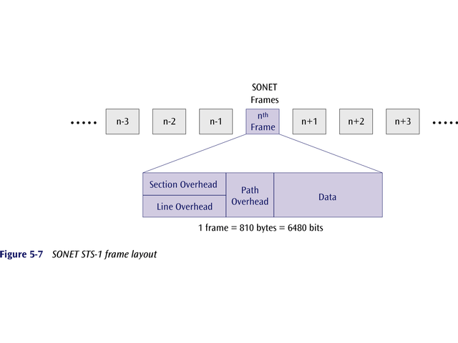
SONET – massive data rates
SONET STS-1 Frame Layout

Slide 131
Synchronous TDM
Very popular
Line will require as much bandwidth as all the bandwidths of the sources

Slide 132
Statistical Time Division Multiplexing
A statistical multiplexor transmits only the data from active workstations (or why work when you don’t have to).
If a workstation is not active, no space is wasted on the multiplexed stream.
A statistical multiplexor accepts the incoming data streams and creates a frame containing only the data to be transmitted.

Slide 133
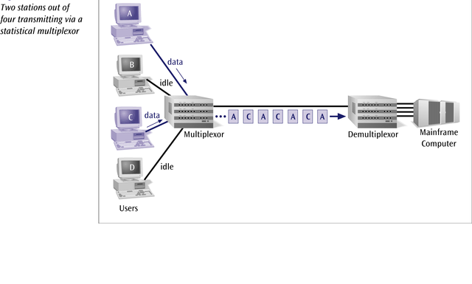

Slide 134
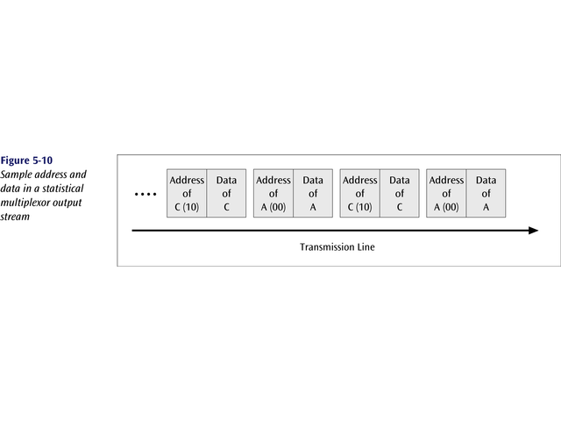
To identify each piece of data, an address is included.

Slide 135

If the data is of variable size, a length is also included.

Slide 136

More precisely, the transmitted frame contains a collection of data groups.

Slide 137
Statistical Time Division Multiplexing
A statistical multiplexor does not require a line over as high a speed line as synchronous time division multiplexing since STDM does not assume all sources will transmit all of the time!
Good for low bandwidth lines (used for LANs)
Much more efficient use of bandwidth!

Slide 138
Wavelength Division Multiplexing (WDM)
Give each message a different wavelength (frequency)
Easy to do with fiber optics and optical sources

Slide 139
Dense Wavelength Division
Multiplexing (DWDM)
Dense wavelength division multiplexing is often called just wavelength division multiplexing
Dense wavelength division multiplexing multiplexes multiple data streams onto a single fiber optic line.
Different wavelength lasers (called lambdas) transmit the multiple signals.
Each signal carried on the fiber can be transmitted at a different rate from the other signals.
Dense wavelength division multiplexing combines many (30, 40, 50, 60, more?) onto one fiber.

Slide 140

Data Signals Transmitted

Slide 141


Slide 142
Code Division Multiplexing (CDM)
Old but now new method
Also known as code division multiple access (CDMA)
An advanced technique that allows multiple devices to transmit on the same frequencies at the same time using different codes
Used for mobile communications

Slide 143
Code Division Multiplexing
An advanced technique that allows multiple devices to transmit on the same frequencies at the same time.
Each mobile device is assigned a unique 64-bit code (chip spreading code)
To send a binary 1, mobile device transmits the unique code
To send a binary 0, mobile device transmits the inverse of code

Slide 144
Code Division Multiplexing
Receiver gets summed signal, multiplies it by receiver code, adds up the resulting values
Interprets as a binary 1 if sum is near +64
Interprets as a binary 0 if sum is near –64

Slide 145


Slide 146
Business Multiplexing In Action
XYZ Corporation has two buildings separated by a distance of 300 meters.
A 3-inch diameter tunnel extends underground between the two buildings.
Building A has a mainframe computer and Building B has 66 terminals.
List some efficient techniques to link the two buildings.

Slide 147


Slide 148
Possible Solutions
Connect each terminal to the mainframe computer using separate point-to-point lines.
Connect all the terminals to the mainframe computer using one multipoint line.
Connect all the terminal outputs and use microwave transmissions to send the data to the mainframe.
Collect all the terminal outputs using multiplexing and send the data to the mainframe computer using a conducted line.

Slide 149
Summary
Multiplexing
Types of multiplexing
TDM
Synchronous TDM (T-1, ISDN, optical fiber)
Statistical TDM (LANs)
FDM (cable, cell phones, broadband)
WDM (optical fiber)
CDM (cell phones)

Slide 150

TRANSMISSION MEDIA
Sending of data from one device to another is called transmission of data.
Medium used to transmit the data is called media.
Transmission of data through medium is called transmission media. So, it is a pathway that carries the information from sender to receiver.
We use different types of cables or waves to transmit data.
Data is transmitted normally in electrical or electromagnetic signals.
Transmission media are located below the physical layer.
Computers use signals to represent data.
Signals are transmitted in from of electromagnetic energy.

Slide 151

Types of transmission media

Slide 152


Twisted-pair Cable
A twisted pair consists of two conductors (normally copper), each with its own plastic insulation, twisted together
One of the wires carries signal, the other is used only as a ground reference.
The receiver uses the difference b/w the two.
Twisting increases, the probability that both wires are effected by the noise in the same manner, thus the difference at the receiver remains same.
Therefore, number of twists per unit length determines the quality of the cable.

Slide 153
Twisted Pair - Transmission Characteristics
Analog
needs amplifiers every 5km to 6km
Digital
can use either analog or digital signals
needs a repeater every 2-3km
Limited distance
Limited bandwidth (1MHz)
Limited data rate (100MHz)
Susceptible to interference and noise

Slide 154

Unshielded Versus Shielded Twisted-Pair Cable
UTP and STP cables

Slide 155
Unshielded Twisted Pair (UTP)
Ordinary telephone wire
Cheapest
Easiest to install
Suffers from external EM interference
Advantages of UTP:
Affordable
Most compatible cabling
Major networking system
Disadvantages of UTP:
Suffers from external Electromagnetic interference
Applications:
Telephone lines connecting subscribers to the central office
DSL lines
LAN – 10Base-T and 100Base-T

Slide 156
Shielded Twisted Pair (STP)
Metal braid or sheathing that reduces interference
More expensive
Harder to handle (thick, heavy)
It offers protective sheathing around the copper wire and Provides better performance at lower data rates.
Not commonly used
Installation is easy
Distance is only 100-500 meters
Special connecters are required.
STP Application
STP is used in IBM token ring networks.
Higher transmission rates over longer distances.
Advantages of STP:
Faster than UTP
Disadvantages of STP:
More expensive than UTP
High attenuation rate

Slide 157
Categories of unshielded twisted-pair cables

Slide 158
Twisted Pair - Applications
Applications
Most common medium
Telephone network
Within buildings
For local area networks (LAN)
Pros and Cons
Cheap
Easy to work with
Low data rate
Short range

Slide 159


Guided Media – Coaxial Cable
Inner conductor is a solid wire outer conductor serves both as a shield
against noise and a second conductor

Slide 160
Characteristics
Superior frequency characteristics
Performance limited by attenuation & noise
Analog signals
amplifiers every few km
closer if higher frequency
up to 500MHz
Digital signals
repeater every 1km
closer for higher data rates

Slide 161

Applications
Most versatile medium
Television distribution
Long distance telephone transmission
Can carry 10,000 voice calls simultaneously
Short distance computer systems links
Local area networks
Analog telephone networks
Cable TV networks
Traditional Ethernet LAN – 10Base2, 10Base5
Categories of coaxial cables

Slide 162

Guided Media – Fiber-Optic Cable
Fiber-optic cable transmit signals in the form of light.
Bending of light ray
Angle of Incidence (I): the angle the ray makes with the line perpendicular to the interface between the two substances
Critical Angle: the angle of incidence which provides an angle of refraction of 90-degrees.

Slide 163


Uses reflection to guide light through a channel
Core is of glass or plastic surrounded by Cladding
Cladding is of less dense glass or plastic

Slide 164
Optical Fiber – Transmission Characteristics
Uses total internal reflection to transmit light
effectively acts as wave guide for 10¹⁴ to 10¹⁵ Hz
Can use several different light sources
Light Emitting Diode (LED)
cheaper, wider operating temp range, lasts longer
Injection Laser Diode (ILD)
more efficient, has greater data rate
Relation of wavelength, type & data rate
Notes:
Optical fiber transmits a signal-encoded beam of light by means of total internal reflection. Total internal reflection can occur in any transparent medium that has a higher index of refraction than the surrounding medium. In effect, the optical fiber acts as a waveguide for frequencies in the range of about 10¹⁴ to 10¹⁵ Hertz; this covers portions of the infrared and visible spectra.
Two different types of light source are used in fiber optic systems: the light-emitting diode (LED) and the injection laser diode (ILD). Both are semiconductor devices that emit a beam of light when a voltage is applied. The LED is less costly, operates over a greater temperature range, and has a longer operational life. The ILD, which operates on the laser principle, is more efficient and can sustain greater data rates.
There is a relationship among the wavelength employed, the type of transmission, and the achievable data rate. Both single mode and multimode can support several different wavelengths of light and can employ laser or LED light sources.

Slide 165

Guided Media – Fiber-Optic Cable
Propagation Modes

Slide 166

Guided Media – Fiber-Optic Cable
Propagation Modes
In multimode step-index fiber, the density of the core remains constant from the center to the edges. A beam of light moves through this constant density in a straight line until it reaches the interface of the core and the cladding.
At the interface, there is an abrupt change due to a lower density; this alters the angle of the beam's motion
In multimode graded-index fiber, decreases this distortion of the signal through the cable.
Density is highest at the center of the core and decreases gradually to its lowest at the edge

Slide 167

Fiber Construction
Applications:
The fiber optic cable is often found in backbone networks because its bandwidth is cost effective.
Telecommunications
Local Area Networks
100Base-FX network (Fast Ethernet)
100Base-X
Cable TV– backbone
CCTV
Medical Education

Slide 168
Fiber Optic Advantages
Greater capacity (bandwidth of up to 2 Gbps) & Smaller size and lighter weight.
Lower attenuation.
greater repeater spacing
o 10s of km at least
More resistance to corrosive materials & immunity to environmental interference.
highly secure due to tap difficulty and lack of signal radiation.
Fiber Optic Disadvantages
Installation and maintenance need expertise
Much more expensive
requires highly skilled installers
adding additional nodes is difficult

Slide 169

UNGUIDED MEDIA: WIRELESS
Unguided media transport electromagnetic waves without using a physical conductor. This type of communication is often referred to as wireless communication.
Electromagnetic spectrum for wireless communication

Slide 170

Propagation methods

Slide 171
Bands

Slide 172

Wireless transmission waves

Slide 173


Radio waves are used for multicast communications, such as radio and television, and paging systems.
They can penetrate through walls.
Highly regulated. Use omni directional antennas

Slide 174

Microwaves are used for unicast communication such as cellular telephones, satellite networks, and wireless LANs.
Higher frequency ranges cannot penetrate walls.
Use directional antennas - point to point line of sight communications

Slide 175
Infrared signals can be used for short-range communication in a closed area using line-of-sight propagation.
Wireless Channels
Are subject to a lot more errors than guided media channels.
Interference is one cause for errors, can be circumvented with high SNR.
The higher the SNR the less capacity is available for transmission due to the broadcast nature of the channel.
Channel also subject to fading and no coverage holes.

